Slide 1

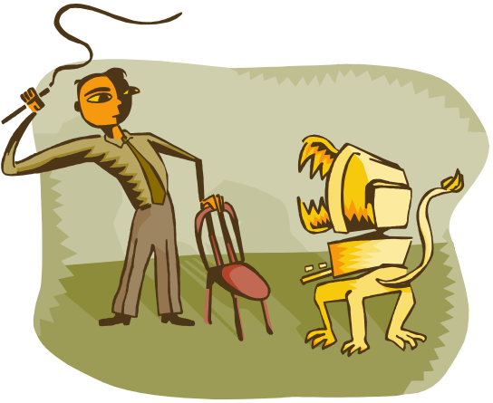
CSC 36000 – Data Structures
Lesson 0

Slide 2


What do these statements have in common ?
Today, the corporation announced that it would suspend payment of dividends to its stockholders.
Society must address the issues of too many beautiful people before it gets out of control.
There is no place like home.
The team played a very good game today despite losing 60 - 7!
The school’s policy is to provide only green and pink students with money.
The government determined that anyone caught jaywalking will
be shot on site.

Slide 3

Today, the corporation announced that it would suspend payment of dividends to its stockholders.
Society must address the issues of too many beautiful people before it gets out of control.
There is no place like home.
The team played a very good game today despite losing 60 - 7!
The school’s policy is to provide only green and pink students with money.
The government determined that anyone caught jaywalking will
be shot on site.

Slide 4


Data Structures is the study of various means of
controlling, implementing, storing, retrieving,
updating and designing data and data systems to
provide fast, efficient, and timely access to data in
a useable, clear and organized manner to the
user.

Slide 5
The basic idea behind Data Structures is the
creation, use, and manipulation of ABSTRACT
DATA TYPES or ADTs.

Slide 6
Types of data:

Slide 7
Types of data:
Atomic – integer, float, bool, char, pointers.

Slide 8
Types of data:
Atomic – integer, float, bool, char, pointers.
Composite – arrays, structures, and classes

Slide 9
Types of data:
Atomic – integer, float, bool, char, pointers.
Composite – arrays, structures, and classes
** ADTs - linked list (regular, stacks, queues)
trees (and all its variations), graphs,
hash tables, heaps, etc.

Slide 10
Def: Abstract data type :
a data type that consist of :
1. a data declaration package.
2. a definition of the operations on the
data that are meaningful.
3. the encapsulation of data and
operations into one entity.

Slide 11
Concept of abstraction means:
1. We know what a data type can do.
2. How it is done is hidden. (Information
Hiding)

Slide 12
In this course, we will explore a few of the basic
forms of ADTs.

Slide 13
In this course, we will explore a few of the basic
forms of ADTs.
We will cover such topics as linked lists, queues, stacks, binary trees, and threaded trees.

Slide 14
In this course, we will explore a few of the basic
forms of ADTs.
We will cover such topics as linked lists, queues, stacks, binary trees, and threaded trees.
Some side topics related to data structures that we will cover are: Recursion and Advanced Sorting Techniques (Quick and Shell sorts).

Slide 15
In this course, we will explore a few of the basic
forms of ADTs.
We will cover such topics as linked lists, queues, stacks, binary trees, and threaded trees.
Some side topics related to data structures that we will cover are: Recursion and Advanced Sorting Techniques (Quick and Shell sorts).
Time permitting we will also look at graphs, hash tables, heaps, tries, and AVL (or Balanced Binary) trees.

Slide 16

Program #1 Assigned
End Of
Lesson Zero

